Slide 1


Cyber Security Risk Analyses
Team Tableau
June, 2022

Slide 2
Team Members
Other Active Members
Project Lead:
Philip Ogunmola
Assistant Project Lead:
Arundarasi Rajendran
Query Analyst:
Abdullateef Kawonise
Anih Nathan Chizoba

Slide 3
Table of Content
1
Problem Statement
2
Aims and Objectives
3
Data Wrangling and Preprocessing
Nullam dictum felis eu pede mollis pretium. Integer tincidunt. Cras dapibus. Vivamus elementum semper nisi.
4
Data visualization, Tableau
5
Exploratory Data Analysis
Nullam dictum felis eu pede mollis pretium. Integer tincidunt. Cras dapibus. Vivamus elementum semper nisi.
6
Statistical Analysis
Aliquam lorem ante, dapibus in, viverra quis, feugiat a, tellus. Phasellus viverra nulla ut metus varius laoreet.
7
Summary
Aliquam lorem ante, dapibus in, viverra quis, feugiat a, tellus. Phasellus viverra nulla ut metus varius laoreet.

Slide 4
Problem Statement
Lack of comprehensive cybersecurity risk analysis system hinders effective vulnerability identification, assessment, and mitigation. Existing methods lack integration of crucial vulnerability information, leaving networks exposed to security breaches, compromising data integrity and confidentiality. Urgent need for a robust solution leveraging CISA Known Exploited Vulnerabilities catalog to provide actionable insights for proactive network protection and risk mitigation against evolving cyber threats.
NUMBER OF UNIQUE IDENTIFIER
NUMBER OF ROWS
NUMBER OF COLUMNS
860
3984
16
Based on the dataset, the cve_id is the unique identifier
This confirms that some unique identifiers have duplicates
We originally had this much columns to deal with
‹#›

Slide 5

Aims and Objectives
Generate meaningful insights from the vulnerability analysis to identify potential risks and threats.
Offer recommendations and actionable steps to mitigate identified vulnerabilities.
Enable organizations and individuals to take proactive measures to protect their networks and data.
‹#›

Slide 6
622
Unique Identifiers (cve_id)
Data Wrangling
Imported the Zipped file of data, unzipped, and combined the datasets
Did a quick check on the dataset, using a dot describe function
Check for columns with null entries and duplicated cve_ids
Handle the null entries and duplicated unique Identifiers (cve_id)
15
Columns
0
Null Entries
‹#›

Slide 7




Further Preprocessing
What we did
Convert data columns to Datetime data type
Convert these columns (date_added, due_date, pub_date) to datetime dtypes for better analysis
New cols. with extracted info from datetime cols.
From the new datetime dtype columns, we further preprocess it to extract the day of the week and the month
New cols. With converted categorical cols.
We converted some columns relevant for our analysis from categorical to numerical
‹#›

Slide 8
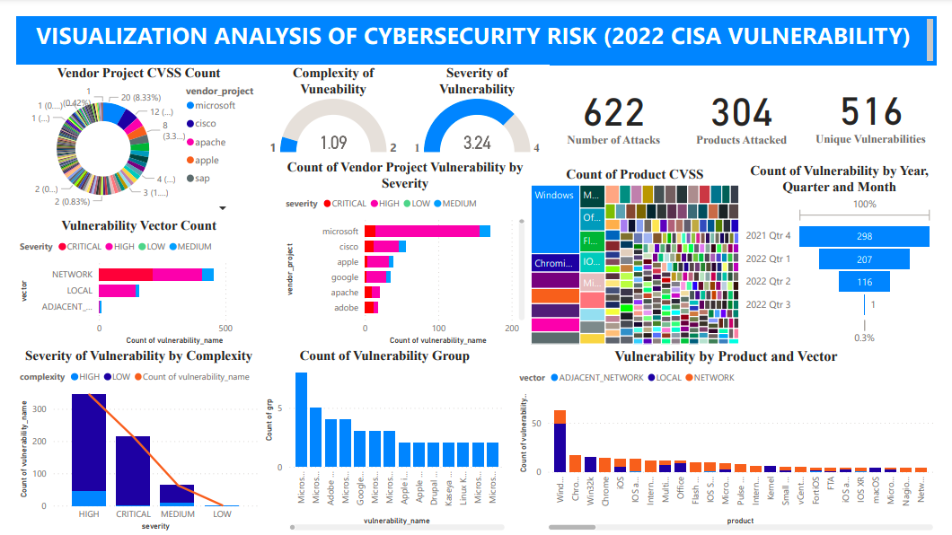
Data visualization, Tableau

Slide 9
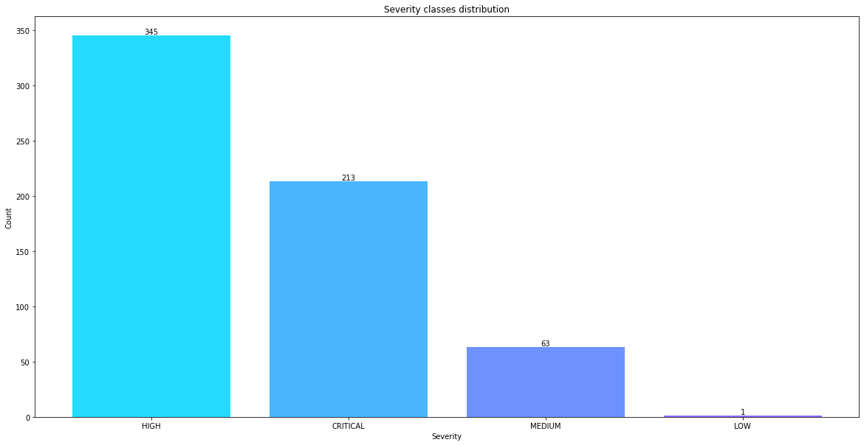
Exploratory Data Analysis
Severity Class distribution
‹#›

Slide 10
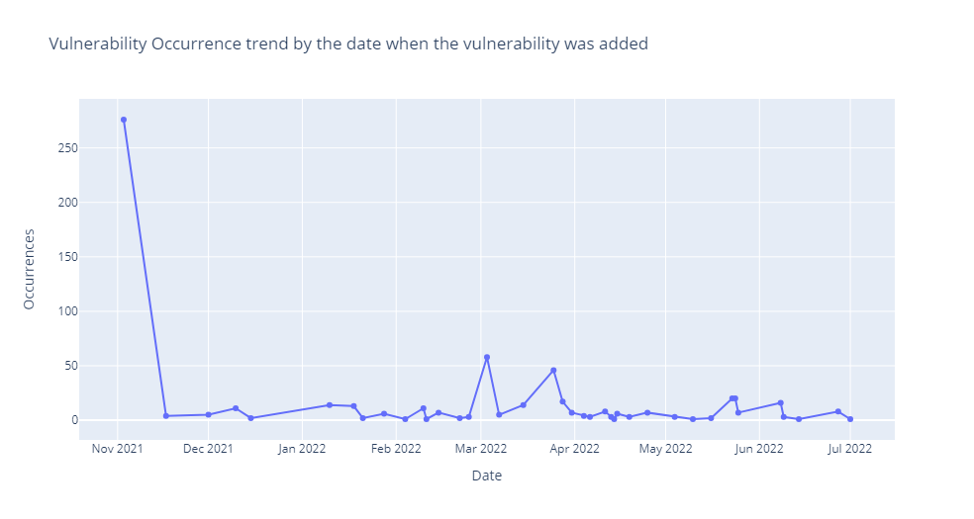
Exploratory Data Analysis
Vulnerability occurrence by date added
‹#›

Slide 11
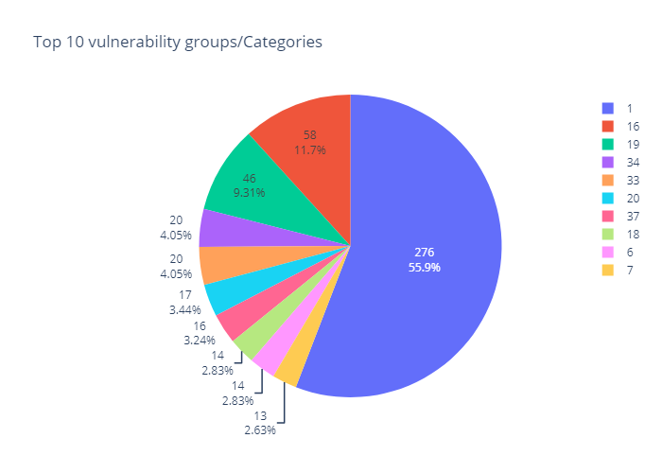
Exploratory Data Analysis
Top 10 Vulnerability Groups/Categories
‹#›

Slide 12
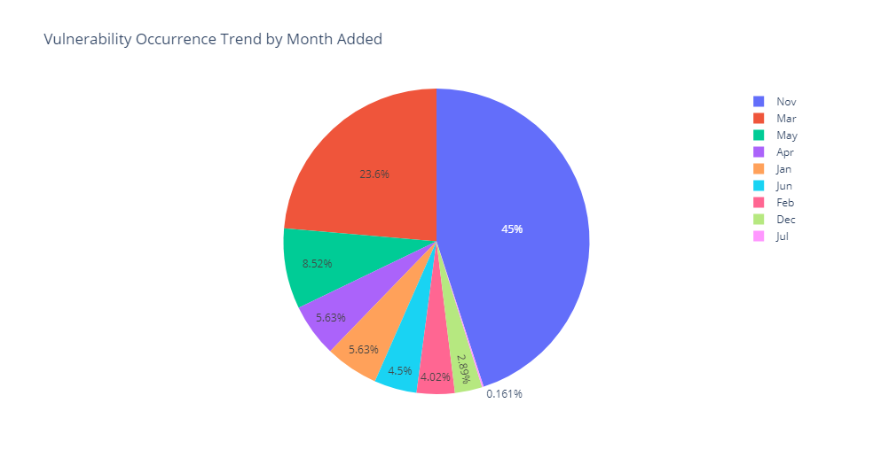
Exploratory Data Analysis
Vulnerability Occurrence Trend by Month Added
‹#›

Slide 13
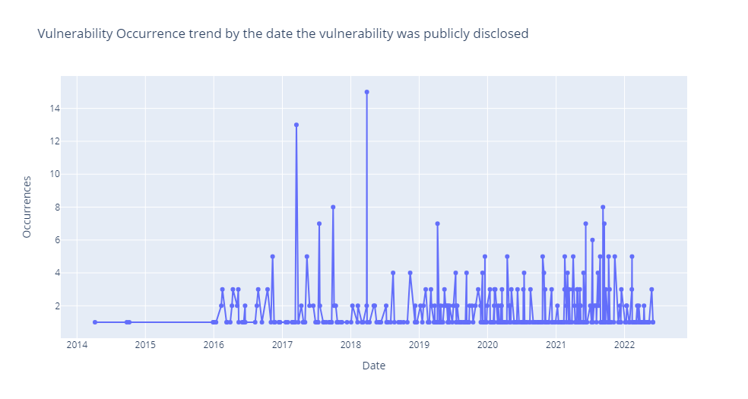
Exploratory Data Analysis
Vulnerability Occurrence trend by the date the vulnerability was publicly disclosed
‹#›

Slide 14
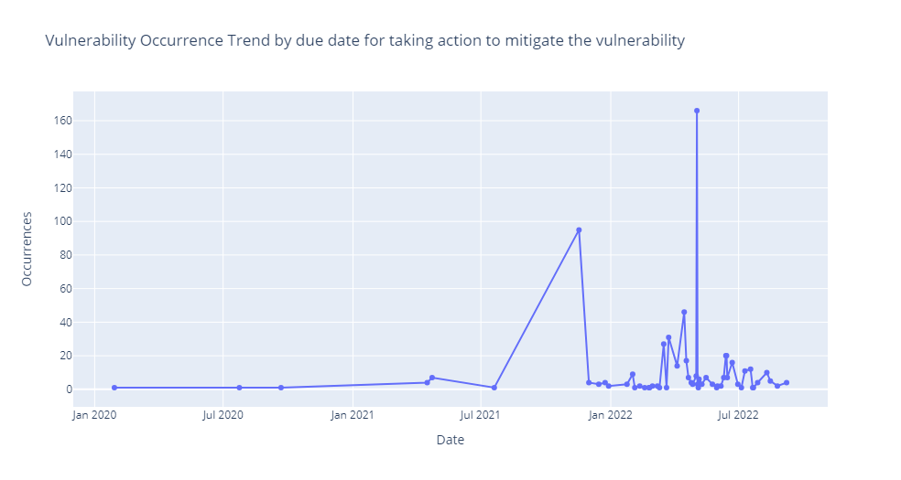
Exploratory Data Analysis
Vulnerability Occurrence Trend by due date for taking action to mitigate the vulnerability
‹#›

Slide 15
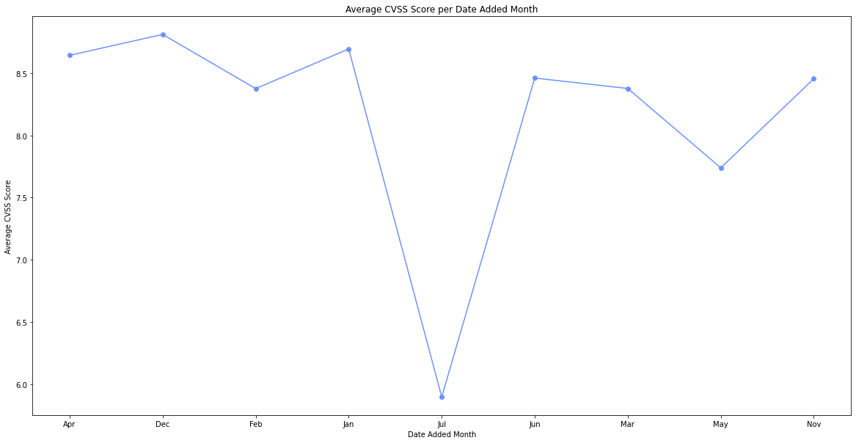
Exploratory Data Analysis
Average CVSS Score per Date Added Month
‹#›

Slide 16

Statistical Analysis
To further gain insights from the data and proffer recommendations to security personnels, we performed some statistical analysis on the data, testing Eleven hypothesis
‹#›

Slide 17
Hypothesis
Vulnerabilities with higher CVSS scores are more likely to have a higher severity level.
Vulnerabilities discovered earlier (date_added) are more likely to have a higher severity level.
Vulnerabilities in certain CWE categories are more likely to have a higher severity level.
Vulnerabilities with a shorter time frame between discovery (date_added) and the due date are more likely to have a higher severity level.
Vulnerabilities disclosed on certain days of the week (pub_date_dayofweek) are more likely to have a higher severity level.
Vulnerabilities in certain vendor projects are more likely to have a higher severity level.
Vulnerabilities with a longer time between disclosure (pub_date) and the due date are more likely to have a higher severity level.
Vulnerabilities with a higher group (grp) value are more likely to have a higher severity level.
Vulnerabilities with certain vectors or methods of exploitation are more likely to have a higher severity level.
Vulnerabilities with a higher complexity level are more likely to have a higher severity level.
Vulnerabilities with a higher CVSS score are less likely to require more complex actions to address them.
‹#›

Slide 18
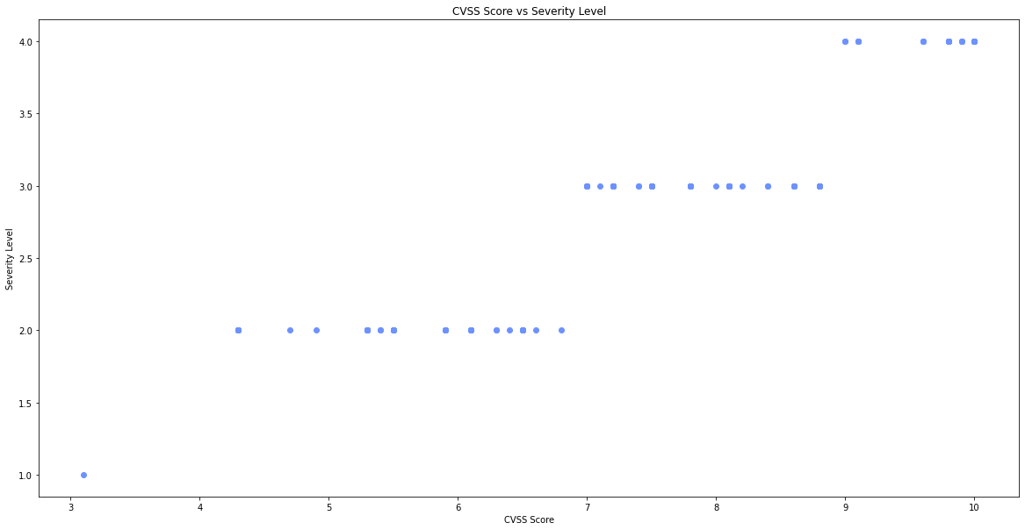
Hypothesis
Vulnerabilities with higher CVSS scores are more likely to have a higher severity level.
Observation.
Correlation coefficient between CVSS score and severity level is 0.9270402556785986. This indicates a strong positive correlation between CVSS score and severity level. This means that as CVSS score increases, severity level increases. In other words, more severe vulnerabilities tend to have higher CVSS scores.
‹#›

Slide 19
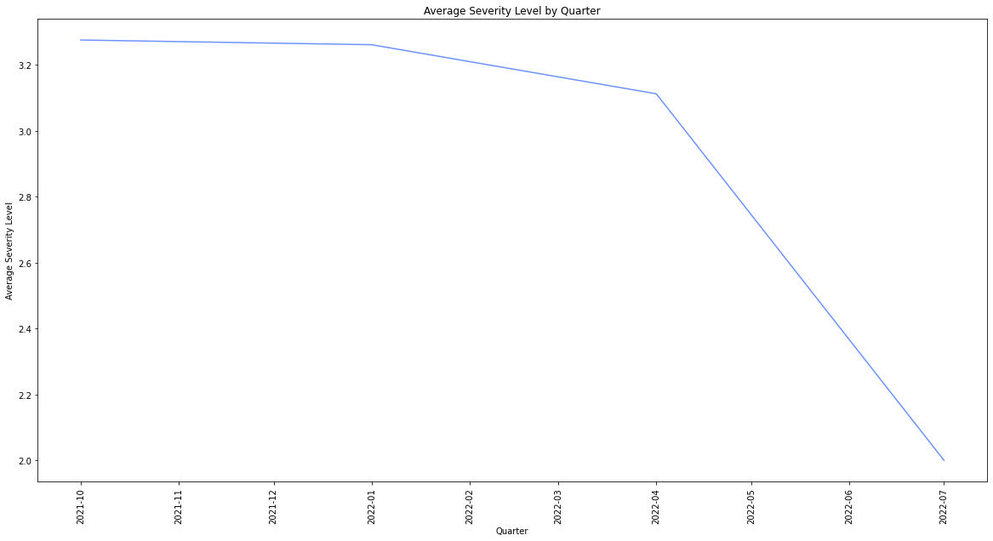
Hypothesis
Vulnerabilities discovered earlier (date_added) are more likely to have a higher severity level.
Observation.
The average severity level of every quarter is HIGH, except for the third quarter of 2022, which is MEDIUM
That there is a statistically significant difference between the average severity levels of the four quarters.
In other words, the data suggests that the average severity level of vulnerabilities decreased from 2021Q4 to 2022Q3.
‹#›

Slide 20
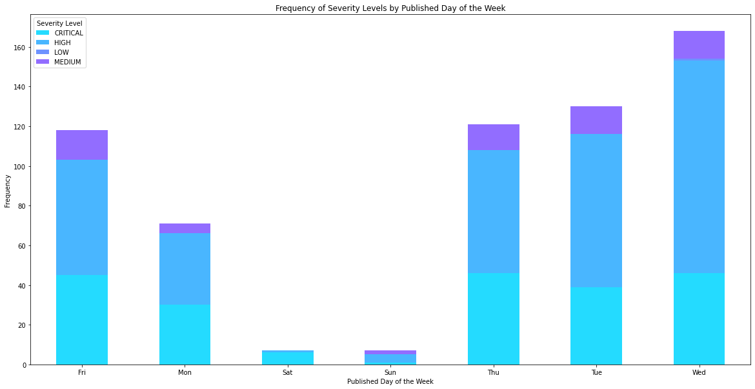
Hypothesis
Vulnerabilities disclosed on certain days of the week (pub_date_dayofweek) are more likely to have a higher severity level.
Observation.
Wednesdays had the highest number of vulnerabilities with the severity level "HIGH," followed by Thursdays and Tuesdays.
Wednesday is the only day where the number of vulnerabilities was recorded as 'LOW'
The p-value of 0.112 suggests that the observed differences in severity levels could be due to chance.
The p-value is higher than the commonly used significance level of 0.05, indicating that the association is not statistically significant.
‹#›

Slide 21
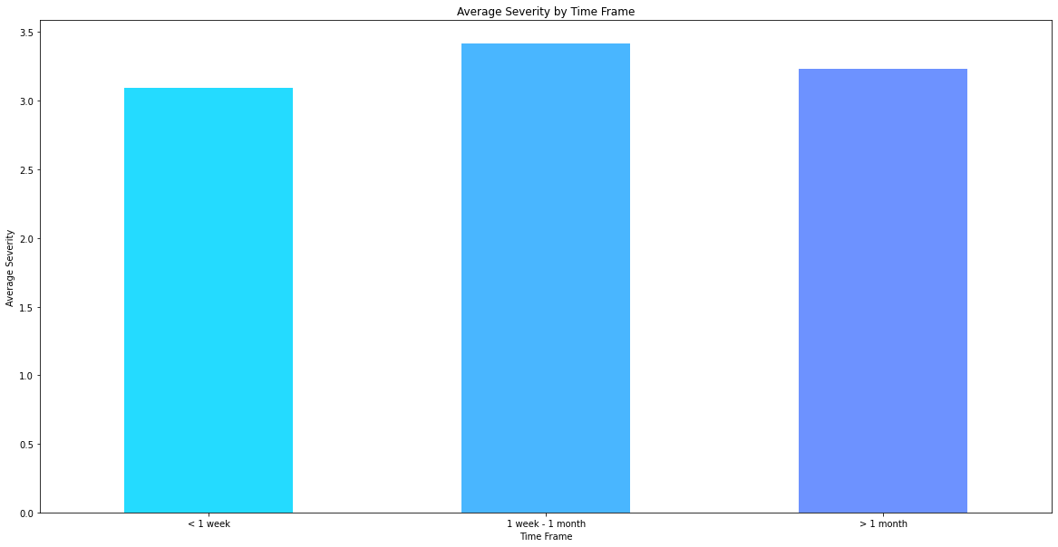
Hypothesis
Vulnerabilities with a longer time between disclosure (pub_date) and the due date are more likely to have a higher severity level.
Observation.
The average severity level does not exhibit a significant difference across the different time frames between vulnerability disclosure and the due date. The p-value of 0.275814417281595 indicates that there is no strong evidence to suggest a significant association between the time frame and severity level of vulnerabilities. Therefore, based on the available data, it can be concluded that the time difference between disclosure and the due date does not have a substantial impact on the severity level of vulnerabilities.
‹#›

Slide 22
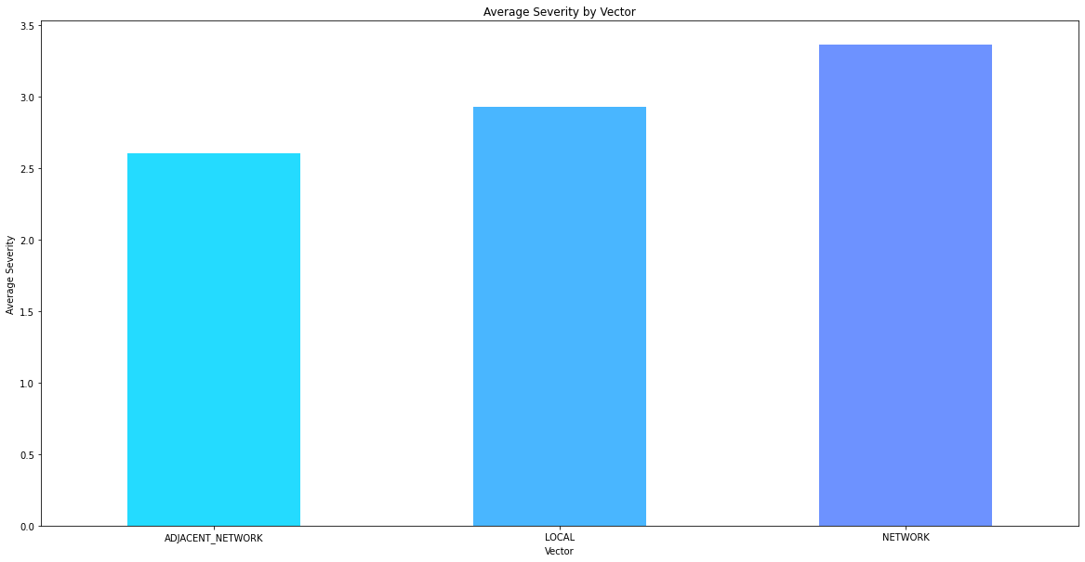
Hypothesis
Vulnerabilities with certain vectors or methods of exploitation are more likely to have a higher severity level.
Observation.
The average severity level varies across different vectors or methods of exploitation. Here are the average severity levels for each vector category:
The ANOVA results indicate a significant difference in severity levels between the vectors, as evidenced by the high F-statistic value of 37.44 and a very low p-value of 4.49e-16. This suggests that the choice of vector or method of exploitation has an impact on the severity level of vulnerabilities.
Based on this observation, it can be concluded that vulnerabilities with certain vectors or methods of exploitation are more likely to have a higher severity level.
‹#›

Slide 23
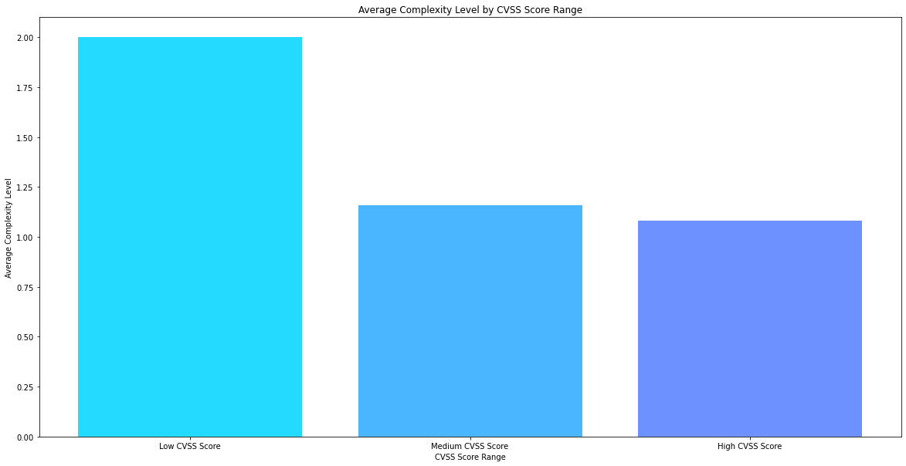
Hypothesis
Vulnerabilities with a higher CVSS score are less likely to require more complex actions to address them.
Observation.
The analysis reveals that vulnerabilities with higher CVSS scores tend to require less complex actions to address them.
The ANOVA results supports the hypothesis (H11) that vulnerabilities with higher CVSS scores are less likely to require more complex actions. The low p-value (0.0009228140205297224) and the relatively high F-statistic (7.067570585091135) indicate a statistically significant difference in complexity levels based on the CVSS scores.
‹#›

Slide 24

Summary
Brief Summary
Correlation coefficient between CVSS score and severity level is highly positive
Earlier date added are more likely to have higher severity level
Certain CWE category are more likely to have high severity level
Certain vendor projects are more likely to have a higher severity level
Vulnerabilities with a higher complexity level are more likely to have a higher severity level
Vulnerabilities with higher CVSS scores tend to require less complex actions to address them. The average complexity level for vulnerabilities with low CVSS scores is 2.0
Challenges faced
Handling the missing values so that not as many data is removed from the dataset
Recommendations for future research
More data is needed to perform more insight that will benefit the company in their decision making
‹#›

Slide 25

Thank You

